Slide 1
AN INNOVATIVE APPROACH FOR FRUIT RIPENESS CLASSIFICATION
BY
Rucha Thakur
Gaurav Suryawanshi
Hardik Patel
Guide: Prof. Janhavi Sangoi

Slide 2
ABSTRACT
Various techniques for fruit ripeness detection have been used in the past, but lower accuracy rate is achieved.
The rate of incorrect fruit ripeness prediction is maximum. Strawberry fruit which is a cash crop as well as seasonal fruit, searching for manual experts for classification is not only costly but also a challenging process.
Manual classification leads to discrete opinions and is more time consuming. Hence finding a cost effective and highly accurate method for strawberry classification yet remains a problem.
Automatic vision based system for sorting and analyzing strawberry fruits based on its maturity level, after being harvested is discussed.
The system is inexpensive and an automatic method to predict ripeness of strawberry fruit without manual experts, depending on the color parameter by Image Processing and Deep Convolutional Neural Network.
The classification will be done into three types: Premature, Mature, and Over-Mature based on the surface color to achieve high accuracy and better segregation of the strawberry fruit.
The system shows 91.6% accuracy.

Slide 3
INTRODUCTION
Agriculture forms the major part of India’s economy. Due to this fact an enormous amount of money is spent by the government for utilization of new advanced technologies to prevent destruction and improve the yield of the crops and soil.
Flavour and aroma of the fruit are determined by maturity level of the fruit. This is typically more difficult in case of strawberries as it is a delicate crop.
Selective grading of strawberry fruit is important to make sure that the adequately ripened strawberry reaches the vendor or fruit market, therefore there is a need to supply quality strawberry fruits within a small period of time
The aim of the model is to reduce the money spent on the manual workers and reduce the discrete opinions they produce by developing an automated system for ripeness detection
Various technology has been study but no complete technology has been developed for ripeness detection which is automatic, user-friendly, accurate, non-destructive and cost-efficient.

Slide 4
LITERATURE SURVEY
TITLE | SUMMARY | ADVANTAGES | TECHNIQUES USED
ASSESSMENT OF FRUIT MATURITY USING DIGITAL IMAGE PROCESSING [1] | Analysis of color is an important consideration when determining the efficiency of fruit. | Real time dataset was used to train the neural network and more are used for testing. | Image processing using Matlab
RGBD ANALYSIS FOR FINDING THE DIFFERENT STAGES OF MATURITY OF FRUITS IN FARMING.[2] | In order to improve the yielding rate of the fruits in its season all over the world, and in turn increase the GDP of the agriculture, farmers from countries like India strive a lot and put in enormous labor to bring out a better yield, in the fruits with a maturity that is required and preferred in the market. | System has achieved 95% training accuracy and 93% testing accuracy | Image Acquisition Depth Filters and Density based Clustering
ESTIMATION OF VOLUME AND MATURITY OF SWEET LIME FRUIT USING IMAGE PROCESSING ALGORITHM [3] | The RG ratio threshold for ripe fruit and unripe lime is fixed. Hence, can be categorized by maturity level. The fruit surface colour has an affinitive relationship with the internal quality, and reflects its maturity [14]. | Maturity is determined with the RGB color coding based on RG ratio. | Image processing algorithm
AGE FACTOR IDENTIFICATION OF TOMATO USING LABVIEW VIA IMAGE PROCESSING. [4] | Tomatoes are one of the most cultivated vegetables worldwide and are extensively grown as secondary crops especially in rice and corn-based farming systems. | It is non-invasive which can lessen the damage to the tomato when inspecting for its ripeness or maturity. | Image Processing, RGB to HSV color that is Hue Saturation formatting.

Slide 5
TITLE | SUMMARY | ADVANTAGES | TECHNIQUES USED
A COST EFFECTIVE TOMATO MATURITY GRADING SYSTEM USING IMAGE PROCESSING FOR FARMERS. [5] | The paper proposes an inexpensive setup utilized for performing the tomato grading process | The proposed algorithm is less complicated and more processor friendly. Hence, accurate and faster classification. | Segmentation along with a simple algorithm to count the total number of white pixels, which determined the maturity level of tomato.
DETERMINATION OF RIPENESS AND GRADING OF TOMATO USING IMAGE ANALYSIS ON RASPBERRY PI. [6] | Color detecting algorithm is used for ripeness determination. This algorithm is implemented on Raspberry Pi to make it independent. | Detects the defects in tomato and classify them in defective class. The result analysis is able to accurately determine the ripeness of tomatoes. | Convert RGB to HSV image of tomato. Creating red mask to determine redness of tomato. cluster to category using K means clustering.
CLASSIFICATION OF ORANGES BY MATURITY, USING IMAGE PROCESSING TECHNIQUES. [7] | The computer vision systems for quality evaluation of food had great acceptance in the food industry, increased demand for objectivity, consistency and efficiency. | Through image processing can identify fruit characteristics in order to optimize selection processes and reduce the time for the classification of fruit | Color uniform background using a CCD (Charge Coupled Device), Image Processing, Image Segmentation and HSV color formats.
DATA CLASSIFICATION WITH DEEP LEARNING USING TENSORFLOW [8] | In the dataset there are 60,000 figures for training and 10,000 figures for testing. Each picture consists of 28x28 pixels. It has been observed that the best accuracy is achieved when the ReLu activation is used. | With the use of relu activation function for data classification, 98.43% classification accuracy is obtained on the test data. | Deep learning using Tensorflow

Slide 6
TITLE | SUMMARY | ADVANTAGES | TECHNIQUES USED
A STRAWBERRY DETECTION USING CONVOLUTIONAL NEURAL NETWORKS. [9] | As agricultural automation becomes more feasible, due in part to lighter and more robust computer vision algorithms, produced detection has emerged as an essential part of the production | The system is fast, precise and affordable for high efficiency, increases speed and precision. | Convolutional Neural Network, Image Input Compression, Color Masking, Image Tiling, Network Compression.
IMAGENET CLASSIFICATION WITH DEEP CONVOLUTIONAL NEURAL NETWORKS [10] | Deep learning is represented as a hierarchy of features i.e. Pixel, edges, modules of object, object, group of objects. | The paper shows that deep convolutional neural networks has been the most successful algorithm for image recognition in the field compared to deep Boltzmann machines, convolutional deep belief networks. | Deep convolutional neural networks
MATURITY AND DISEASE DETECTION IN TOMATO USING COMPUTER VISION. [11] | As fruits are perishable and their intake is in fresh stage, of many existing fruit disorders, immaturity and ripening are common ones. | Using neural network, it is easy to work on the database having more information about large varieties of tomato | Image acquisition, Pre-processing Detection and Segmentation (Thresholding), K- Means Clustering Algorithm
A NEW APPROACH TO IMAGE CLASSIFICATION BY CONVOLUTIONAL NEURAL NETWORK. [12] | Comparing various methods for image classification by considering color component as the basic feature. | The Convolutional Neural Network predicted the image classification with accuracy of 94%. | Convolutional Neural Network.
PREDICTING FRUIT MATURITY STAGE DYNAMICALLY BASED ON FUZZY RECOGNITION AND COLOR FEATURE [13] | Tomato is the most investigated member of fleshy fruit regarding fruit development and ripening. | It is a non-destructive method for determination of maturity level of tomato. | Signal Image Acquisition, Red Area and Hue Abstraction.

Slide 7
PROPOSED SYSTEM
An inexpensive method for classifying strawberries into classes according to ripeness, the system is developed using Convolutional Neural Network. For the success of classification, it is important that appropriate features are extracted. Surface color, size and shape feature for the basis of classification. The surface color of strawberry fruit determines its ripeness level. CNN is used to extract color, size and shape features from strawberry surfaces.
As the CNN algorithm performs automatic feature extraction, it is best suited for the purpose. The system in the initial layer that is 3x3 convolutional layer, converts the input image into matrix and the image is resized into (x, y) pixels.
The input image matrix is then converted into Normalised matrix using Batch Normalization. Batch Normalization is based on a maximum pixel algorithm. The output derived from Batch Normalization is passed on to the 2x2 Max Pooling layer. The Max Pooling layer produces a 2x2 matrix. This layer is the most significant layer in CNN, as it is used for Feature Extraction. The next layer is the flatten layer. The flatten layer is a neural network. It learns from the data so as to perform the necessary prediction. The final layer before the output is the Dense layer. It performs the necessary classification and is required to predict the image into either of 3 classes.
The output is provided by the Dropout layer. For each set i.e. for each premature, mature and over mature, there is 1 dropout. Since the classification is to be done into 3 classes, the system is built with 3 Dropout.

Slide 8
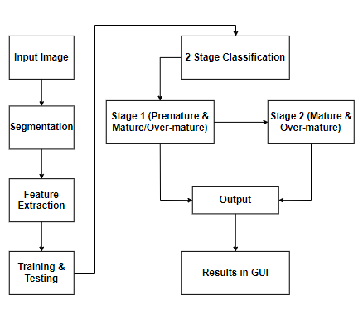
BLOCK DIAGRAM

Slide 9
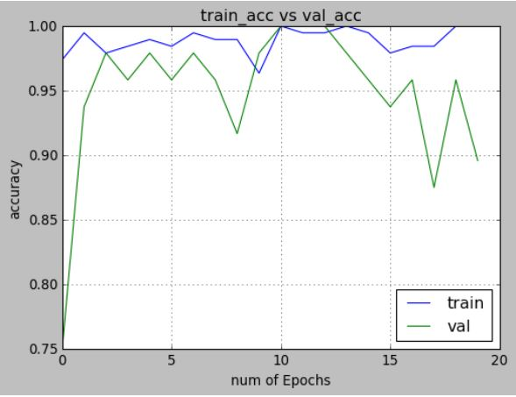
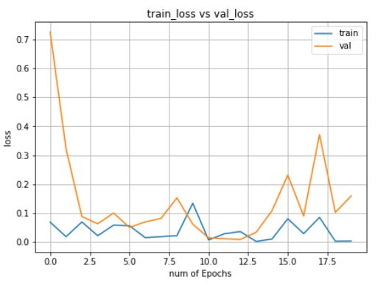
RESULTS
Result obtained after completing of training is as shown above. The plot is accuracy vs number of epochs for training accuracy and validation accuracy. The accuracy for each of the epoch is shown for each of training and validation.
The above figure shows Training and Validation Loss of the model. The plot of loss vs number of epochs to testing and validation loss. It tells how bad the model’s prediction was for the data. Low training and validation loss are achieved.

Slide 10
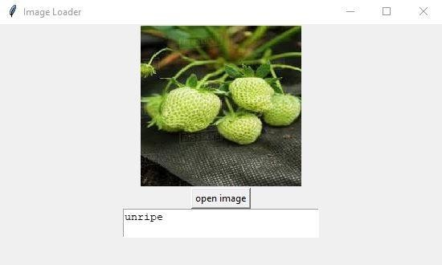
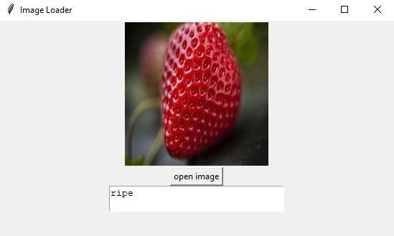
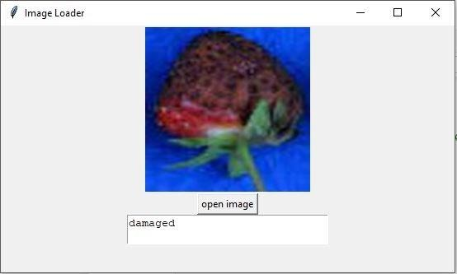
The image is classified as unripe that is premature by the model. The GUI displays the image classifies along with the class.
The image is classified as ripe that is mature by the model. The GUI displays the image classifies along with the class.
The image is classified as damaged that is over-mature by the model. The GUI displays the image classifies along with the class.

Slide 11
CONCLUSION AND FUTURE SCOPE
The Image processing technique using CNN used for determining the fruit maturity level. Various algorithms and feature extraction techniques are used to extract features from the image.
The system reduces the human effort required to classify the strawberry into classes depending on the maturity level along with reducing the possibility of discrete opinions created by the manual experts.
Hence, human errors are reduced to great extents as the system makes decisions by learning through training done using large dataset.
The time required will be comparatively less and the requirement of manual experts is reduced. The developed system achieves 91.6% accuracy.
For further improvement in accuracy, a vibrating conveyor belt can be implemented to provide a clear view from all sides.

Slide 12
REFERENCE
[1] Kranti Raut, Prof. Vibha Bora,’’Assessment of Fruit Maturity using Digital Image Processing”, IJSTE ISSN : 2349-784X, Volume 3, Issue 01, July 2016
[2] Chandy, Abraham. "RGBD ANALYSIS FOR FINDING THE DIFFERENT STAGES OF MATURITY OF FRUITS IN FARMING." Journal of Innovative Image Processing (JIIP) 1, no. 02 (2019): 111-121.
[3] Gokul, P. R., Raj, S., & Suriyamoorthi, P. (2015). Estimation of volume and maturity of sweet lime fruit using image processing algorithm. 2015 International Conference on Communications and Signal Processing (ICCSP), doi:10.1109/iccsp.2015.7322703
[4] Aviso, M. J. A., Cabao-an, A. M. S., Niverba, N. A. P., & Anacan, R. M. (2018). Age Factor Identification of Tomato Using Labview via Image Processing. TENCON 2018 - 2018 IEEE Region 10 Conference. doi:10.1109/tencon.2018.8650189
[5] Rupanagudi, S. R., Ranjani, B. S., Nagaraj, P., & Bhat, V. G. (2014). A cost effective tomato maturity grading system using image processing for farmers. 2014 International Conference on Contemporary Computing and Informatics (IC3I).doi:10.1109/ic3i.2014.7019591
[6] Mhaski, R. R., Chopade, P. B., & Dale, M. P. (2015). Determination of ripeness and grading of tomato using image analysis on Raspberry Pi. 2015 Communication, Control and Intelligent Systems (CCIS). doi:10.1109/ccintels.2015.7437911
[7] Diana Carolina, C. P., & Deivis David, N. T. (2014). Classification of oranges by maturity, using image processing techniques. 2014 III International Congress of Engineering Mechatronics and Automation (CIIMA).doi:10.1109/ciima.2014.698

Slide 13
[8] Fatih Ertam, Galip AydÕn,”Data Classification with Deep Learning using Tensorflow”,IEEE:International Conference on Computer Science and Engineering (UBMK), 2017
[9] Lamb, N., & Chuah, M. C. (2018). A Strawberry Detection System Using Convolutional Neural Networks. 2018 IEEE International Conference on Big Data (Big Data).doi:10.1109/bigdata.2018.8622466
[10] A. Krizhevsky, I. Sutskever, G. E. Hinton, "ImageNet classification with deep convolutional neural networks", Proc. Int. Conf. Neural Inf. Process. Syst., vol. 60, pp. 1097-1105, 2012.
[11] Mehra, T., Kumar, V., & Gupta, P. (2016). Maturity and disease detection in tomato using computer vision. 2016 Fourth International Conference on Parallel, Distributed and Grid Computing (PDGC). doi:10.1109/pdgc.2016.7913228
[12] Shahid, S. I., & Shahjahan, M. (2017). A new approach to image classification by convolutional neural network. 2017 3rd International Conference on Electrical Information and Communication Technology (EICT). doi:10.1109/eict.2017.8275240
[13] Xiao, Q., Niu, W., & Zhang, H. (2015). Predicting fruit maturity stage dynamically based on fuzzy recognition and color feature. 2015 6th IEEE International Conference on Software Engineering and Service Science (ICSESS).doi:10.1109/icsess.2015.7339210
[14] Xu Liming *, Chen Liming, Wang Haifeng, “Strawberry Maturity Distinguish Based on Relationship of Extracted Colour Feature Value and the Physiologic and Biochemical Indices”, 2015 International Conference on Communications and Signal Processing (ICCSP),DOI: 10.1109/ICCSP.2015.7322703.

Slide 14
THANK YOU

